Slide 1
Attosecond FEL pulses: physical and technical challenges
Takashi Tanaka
RIKEN SPring-8 Center

Slide 2
Introduction
Principle of Monocycle FELs
How to Implement in FELs
Numerical Examples
Summary & Outlook

Slide 3
Introduction
Principle of Monocycle FELs
How to Implement in FELs
Numerical Examples
Summary & Outlook

Slide 4
Shortest Pulse Lengths
Unattainable
Region
Zepto
Unattained
Region
Theoretical Limit
Atto
HHG
Optical Laser
SACLA
Femto

Slide 5
Slippage Disturbs Realization of Monocycle FEL
Optical Slippage: Light goes ahead of electrons when they travel an undulator
Monocycle Pulse → Multicycle Microbunch
Monocycle Microbunch → Monocycle Pulse

Slide 6
Introduction
Principle of Monocycle FELs
How to Implement in FELs
Numerical Examples
Summary & Outlook

Slide 7
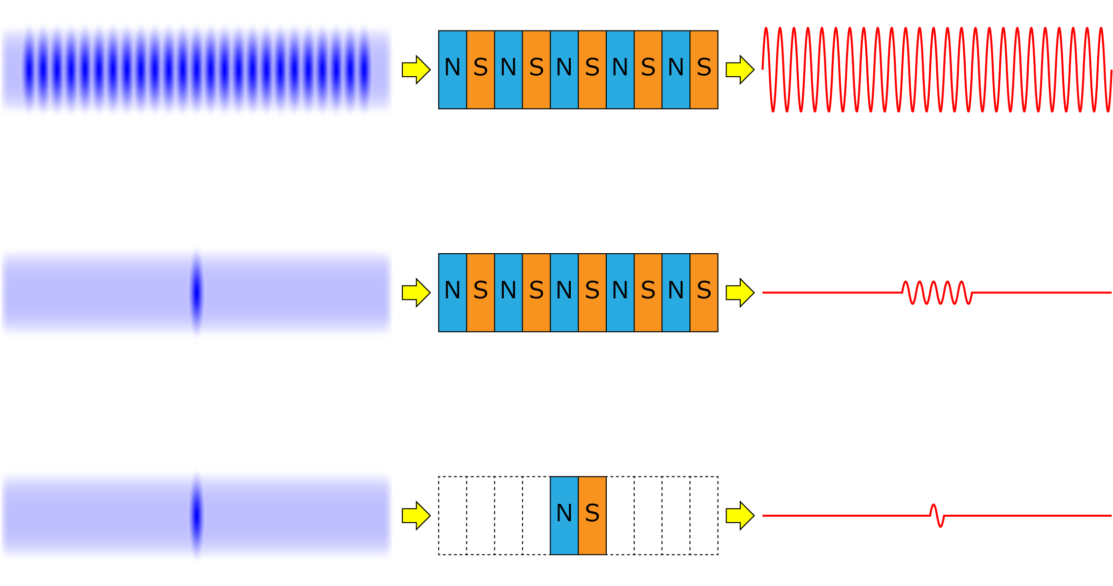
Pulse Length in FELs
Electron Beam
Undulator
FEL
# Microbunches: N
# Periods M(<<N)
Pulse Length: Nλ_{x}
New Method to Generate a Monocycle Pulse
Avoid pulse lengthening by slippage, even with N=M$≫$1
N=1
# Periods M
Pulse Length: Mλ_{x}
Pulse Lengthening by Slippage
N=1
M=1
Pulse Length: λ_{x}

Slide 8
Basic Concept
“Chirped”
Microbunch
Strongly Tapered Undulator
Monocycle Pulse
Necessary Condition
Interval at the n-th microbunch
＝Slippage at the n-th period

Slide 9
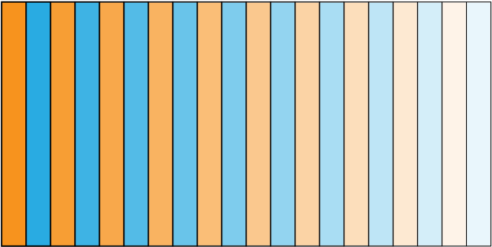
Principle of Operation
j
λ
λ
λ
λ
Current Profile
1
2
3
10
s
E
Radiation Profile at Each Period
s

Slide 10
Principle of Operation
j
λ
λ
λ
λ
1
2
3
10
s
Resonant Pulse
E
After 1st Period
s
λ
1

Slide 11
Principle of Operation
j
λ
λ
λ
λ
1
2
3
10
s
E
After 2nd Period
λ₂
s
λ₁+λ₂

Slide 12
Principle of Operation
j
λ
λ
λ
λ
1
2
3
10
s
E
After 3rd Period
λ₃
s
λ₁+λ₂+λ₃

Slide 13
Principle of Operation
j
λ
λ
λ
λ
1
2
3
10
s
E
After 4th Period
s

Slide 14
Principle of Operation
j
λ
λ
λ
λ
1
2
3
10
High Power Monocycle Pulse
s
E
After 10th Period
s

Slide 15
Mathematical Explanation
Temporal profile of radiation field
Profile of chirped microbunch
Profile of tapered UR by a single electron
Necessary condition
Larger taper gives shorter pulse length
Spectrum of tapered UR
Broadband
Constant phase

Slide 16
Overview of “Seeded” FELs
Principle of Monocycle FELs
How to Implement in FELs
Original Scheme [1]
Modified Scheme [2]
Numerical Examples
Summary & Outlook
[1] T. Tanaka, Phys. Rev. Lett. 114, 044801 (2015)
[2] Y. Kida, R. Kinjo, and T. Tanaka, Appl. Phys. Lett., 109, 151107 (2016)

Slide 17
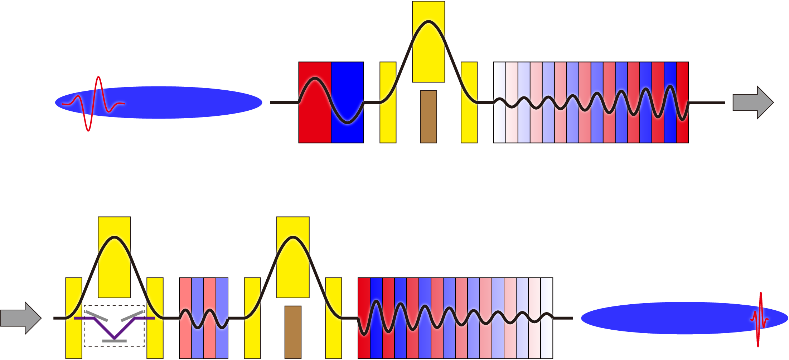
Accelerator Layout
Monocycle
Pulse (λ=λ_{in})
e⁻ bunch
(i)
(ii)
Monocycle
Pulse (λ=λ_{in}/n)
(iii)
(iv)
(v)
Upconvert the monocycle pulse with λ_{in}
Monocycle Harmonic Generation (MCHG)

Slide 18
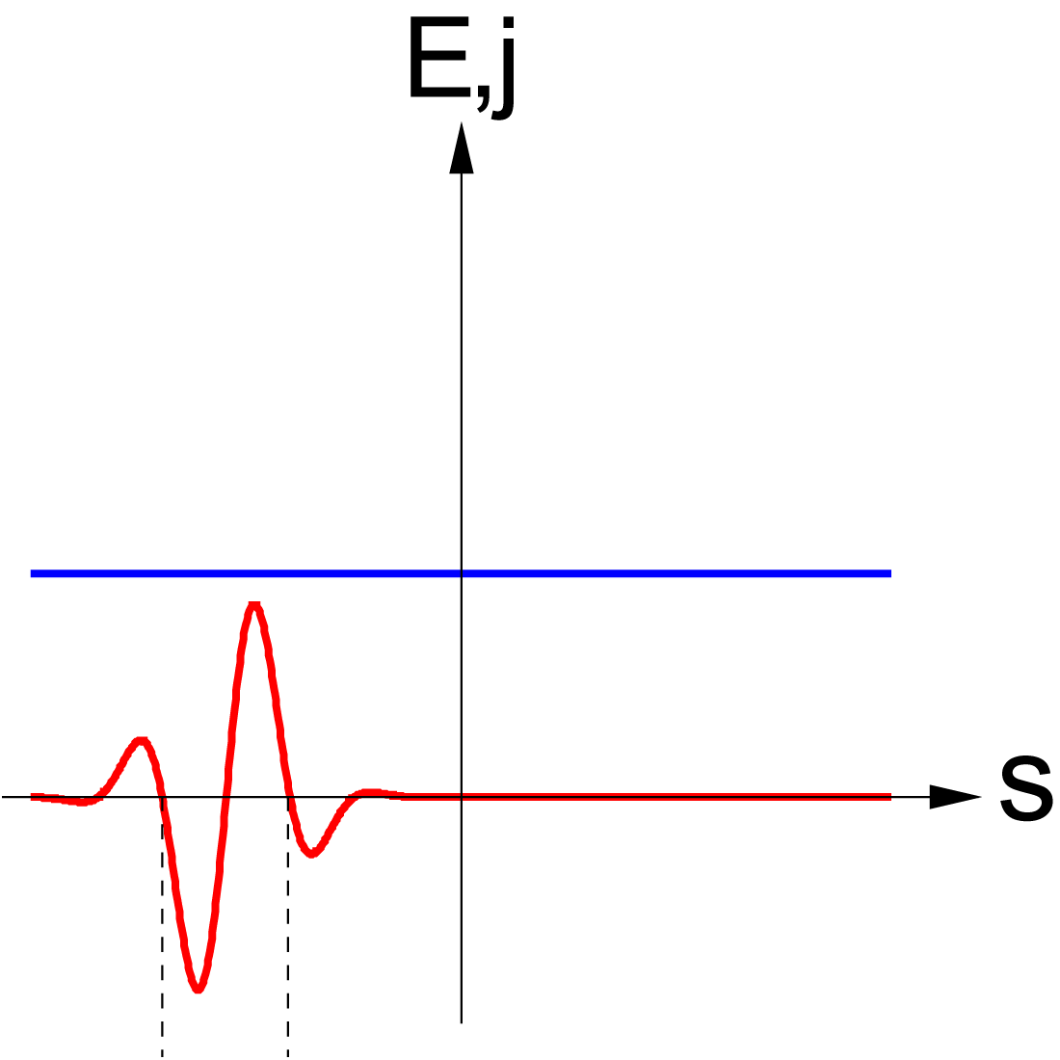
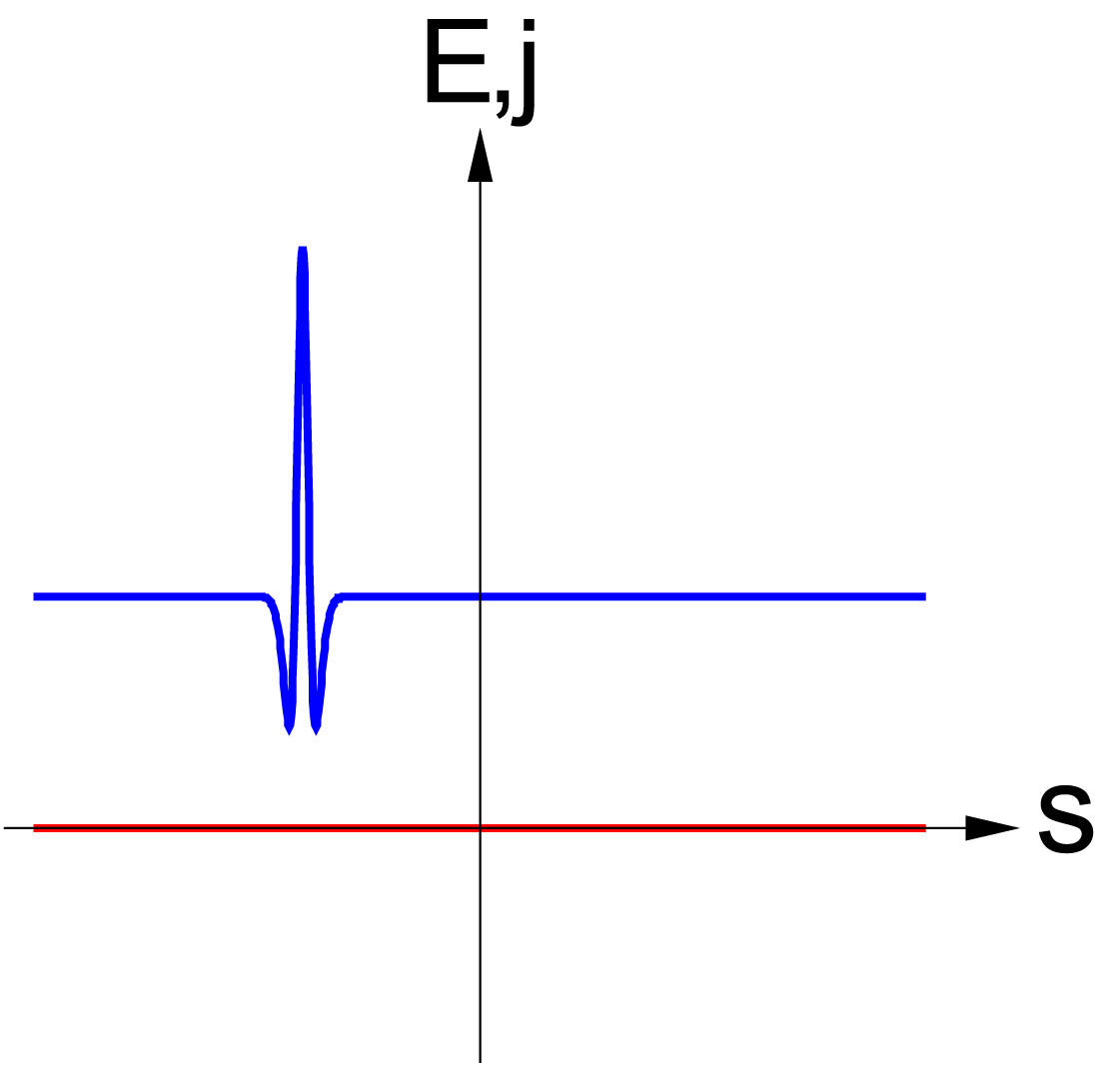
Sec.(i)：Generating a Single Microbunch
(i)
j
E
λ₀

Slide 19
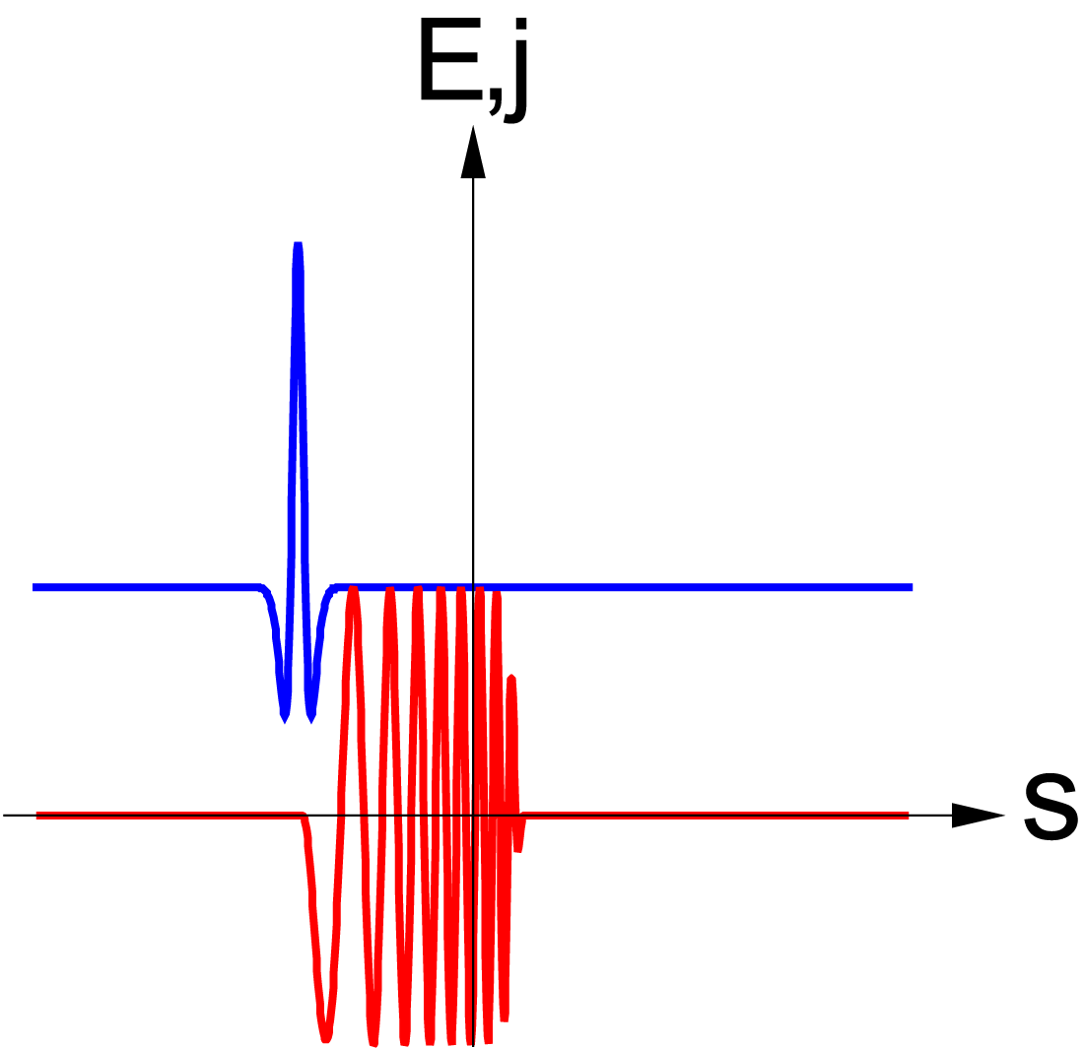
Sec.(ii)：Generating a Chirped Pulse
(ii)
j
E

Slide 20
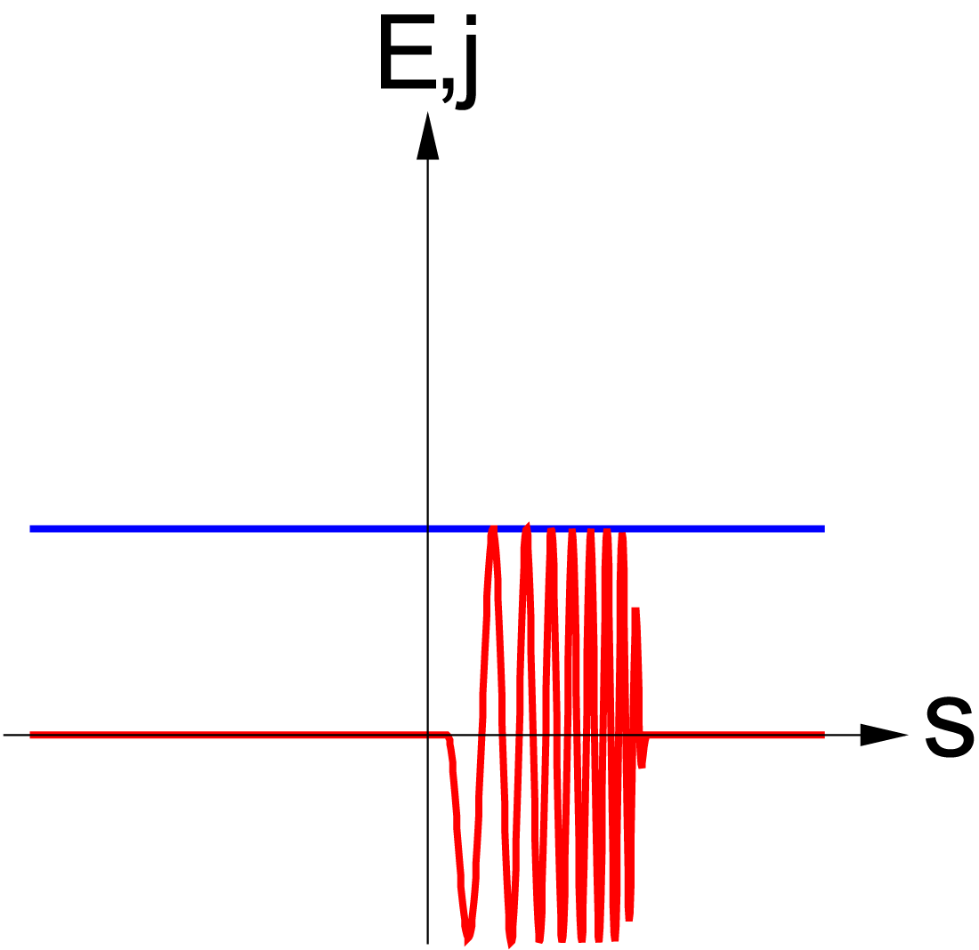
Sec.(iii)：Applying Fresh Bunch
(iii)
j
E

Slide 21
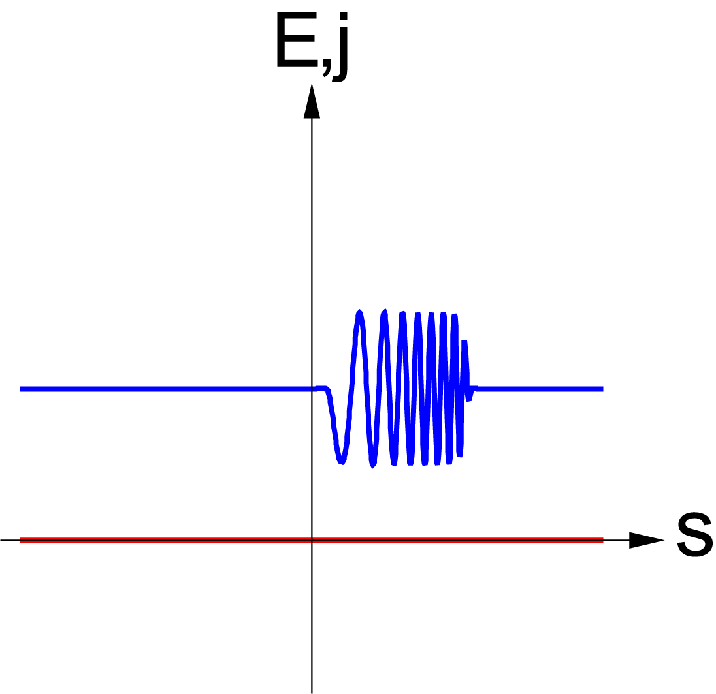
Sec.(iv) : Generating a Chirped Microbunch
(iv)
j
E

Slide 22
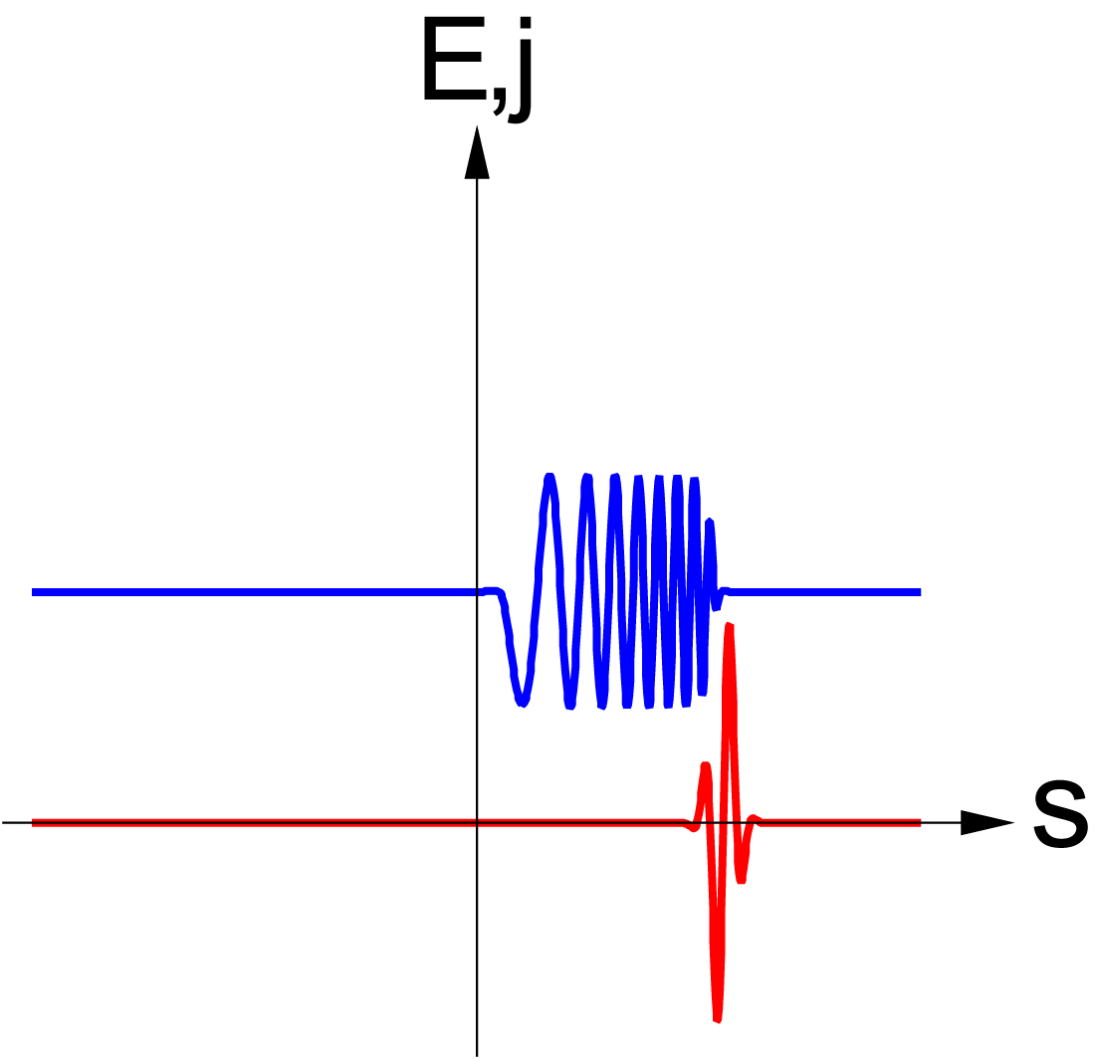
Sec.(v)：Generating a Monocycle Pulse
(v)
j
E

Slide 23
Overview of “Seeded” FELs
Principle of Monocycle FELs
How to Implement in FELs
Original Scheme [1]
Modified Scheme [2]
Numerical Examples
Summary & Outlook
[1] T. Tanaka, Phys. Rev. Lett. 114, 044801 (2015)
[2] Y. Kida, R. Kinjo, and T. Tanaka, Appl. Phys. Lett., 109, 151107 (2016)

Slide 24
Difficulties in the Original Scheme
Complicated accelerator layout
Most of them are necessary just to prepare the chirped microbunch
Stringent requirement on the e⁻ beam
The performance is extremely sensitive to the energy spread
Creating the chirped microbunch with λ_{in}/n using the monocycle seed pulse with λ_{in} is the key issue.

Slide 25
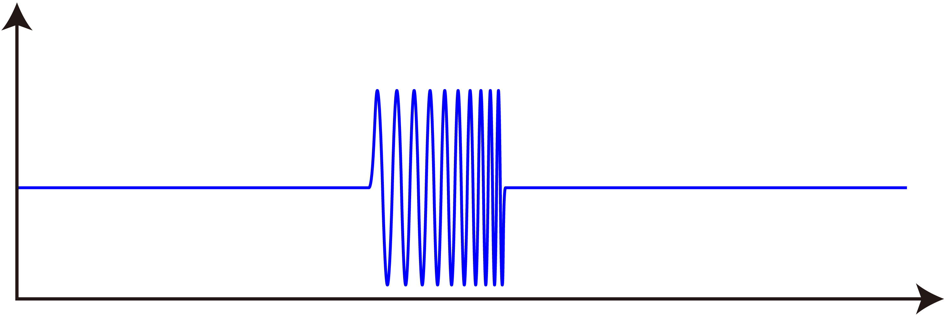
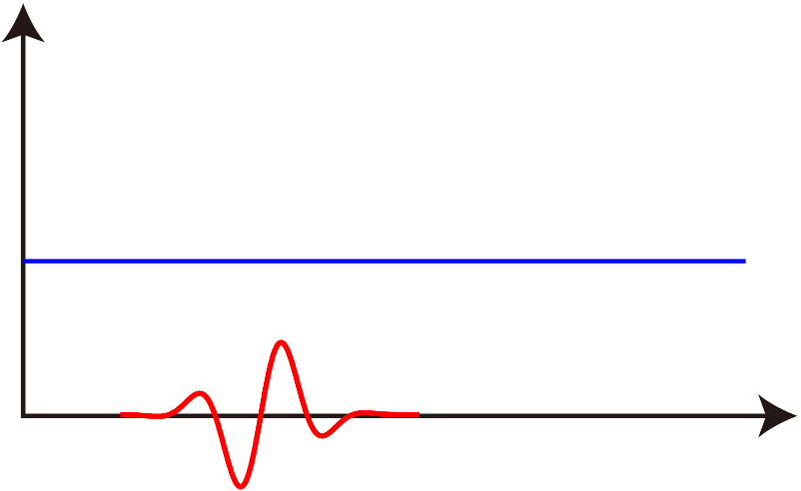
How to Modify?
Complicated process & layout needed
λ_{in}/n
j
E
λ_{in}
t
Simple
process
λ_{in}
Still works, as long as is satisfied

Slide 26
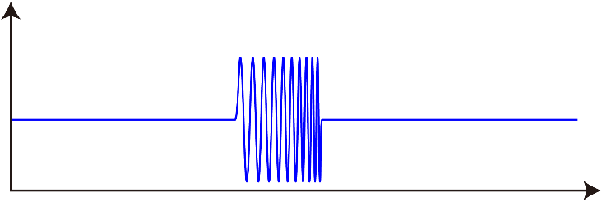
Modified Scheme for MCHG
Original
Modified

Slide 27
Overview of “Seeded” FELs
Principle of Operation
How to Implement in XFELs
Numerical Examples
Summary & Outlook

Slide 28
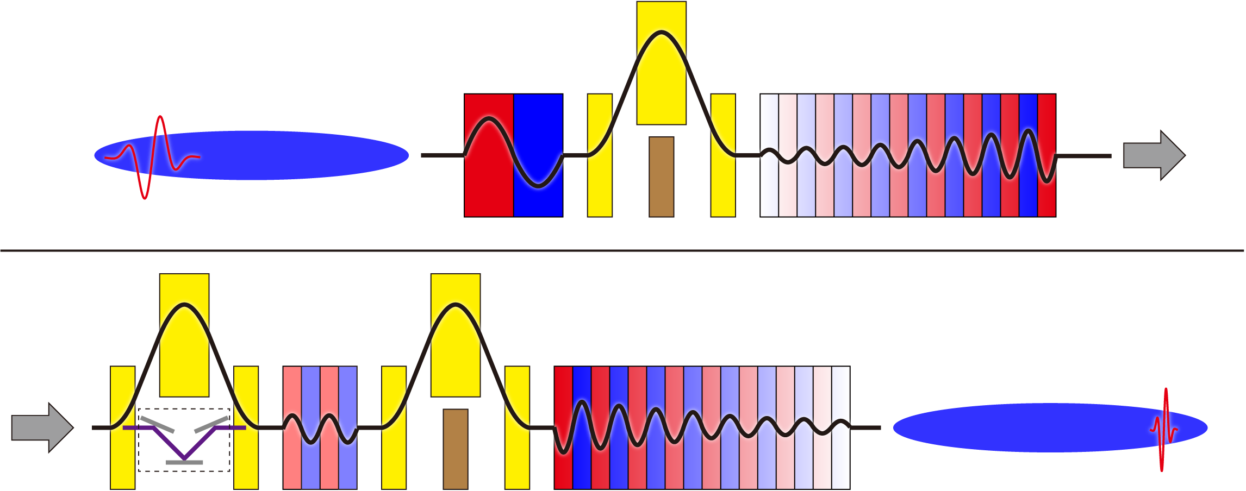
Parameters: Original Scheme
λ_{u}=170mm
K=3.13
N=1
R₅₆=15μm
e⁻ beam
E=2GeV
I=2kA
ε=0.4μm
σE/E=0.5x10⁻⁴
Seed Pulse [1]
P.E.=10μJ
λ=60nm
Δt=0.38fs
λ_{u}=27mm
K=3,ΔK=1.5
N=60
λ_{u}=27mm
K=3,ΔK=-1.5
N=60
λ_{u}=81mm
K=1.39
N=2
R₅₆=24μm
R₅₆=0.2mm
[1] E. J. Takahashi, P. Lan, O. D. Muecke, Y. Nabekawa
and K. Midorikawa, Nat. Commun. 4, 2691 (2013).

Slide 29
Results (n=7)

Slide 30
Results (n=7)
50as

Slide 31
Parameters: Modified Scheme
Seed Pulse
P.E.=10μJ
λ=60nm
Δt=0.38fs
e⁻ beam
E=2GeV
I=2kA
ε=0.4μm
σE/E=10⁻⁴
λ_{u}=170mm
K=4.43 ΔK=-1.9
N=30

Slide 32
Simulation Results
13as

Slide 33
Summary & Outlook
Modified scheme more realistic
Simpler accelerator layout
Less sensitivity to e-spread
The scheme can be cascaded for
Further shortening the pulse length
Two color (or pulse length) operation
Proof-of-principle experiments should be made!
External fund & suitable facility required
Collaboration with several groups under exploration in THz region

